Slide 1

By Quindarisu Booker
Final presentation

Slide 2
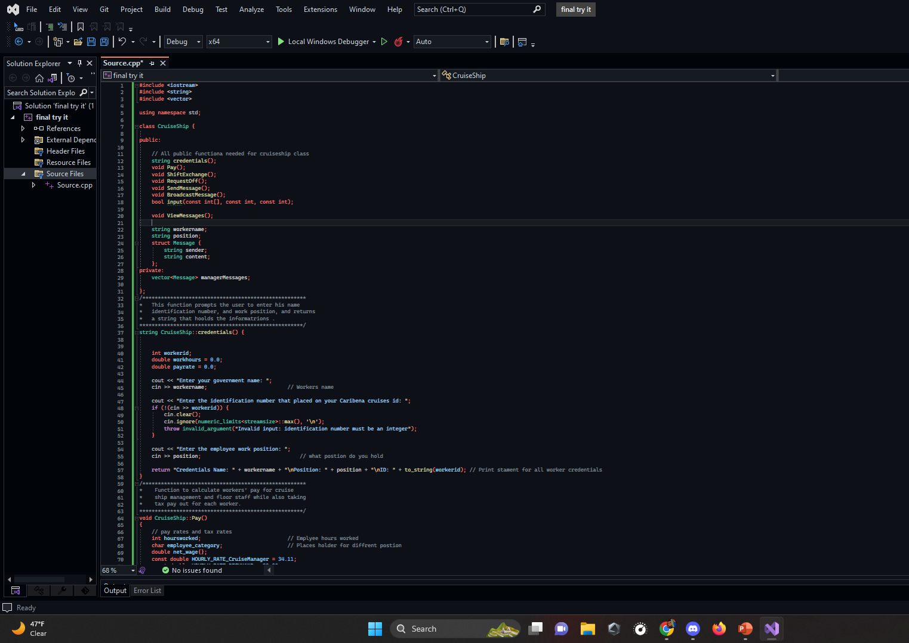
Class/ Credentials function
The credentials() function is used to get the employee's name, identification number, and work position, and returns a string that holds the information..

Slide 3
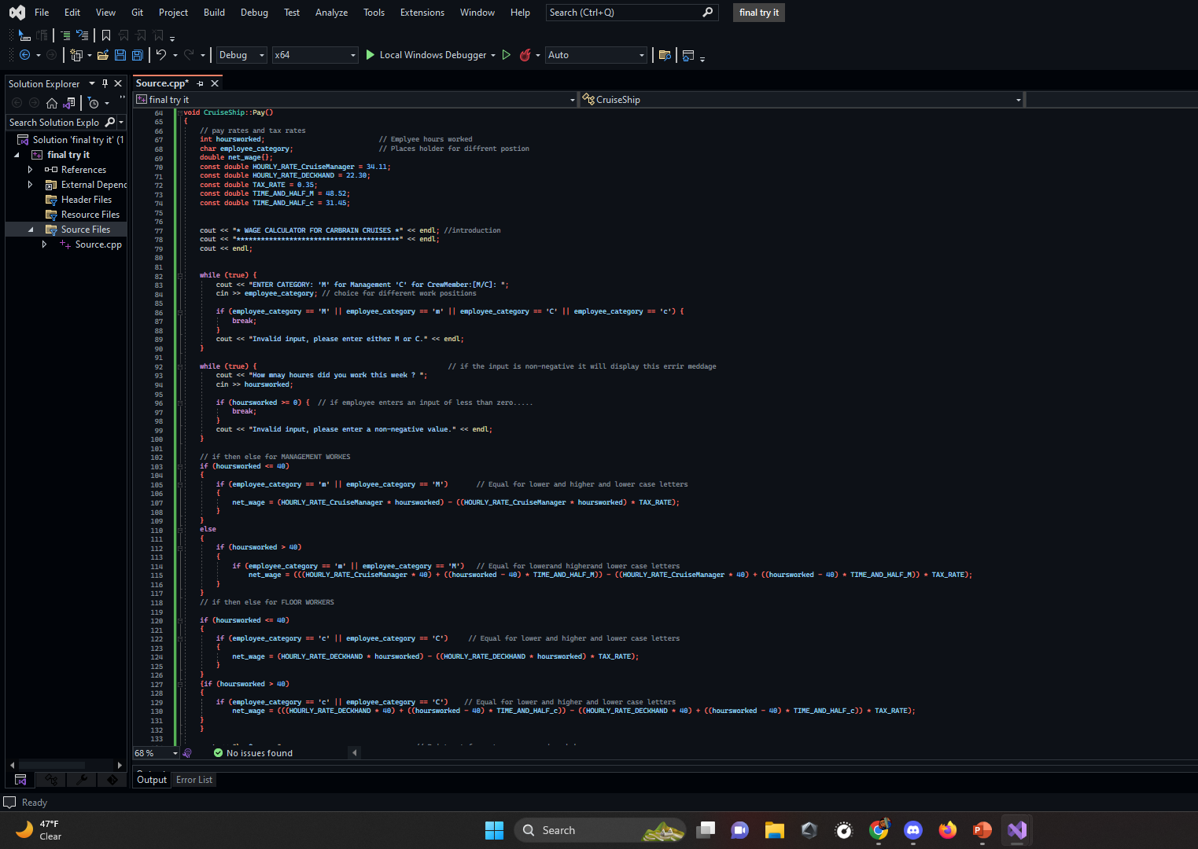
Pay function
The pay function calculates the workers pay for the week based on their position and hours worked
They are given the choice to choose if they work a manger rial position of a crew member position their asked for how many hours they have worked for the week

Slide 4
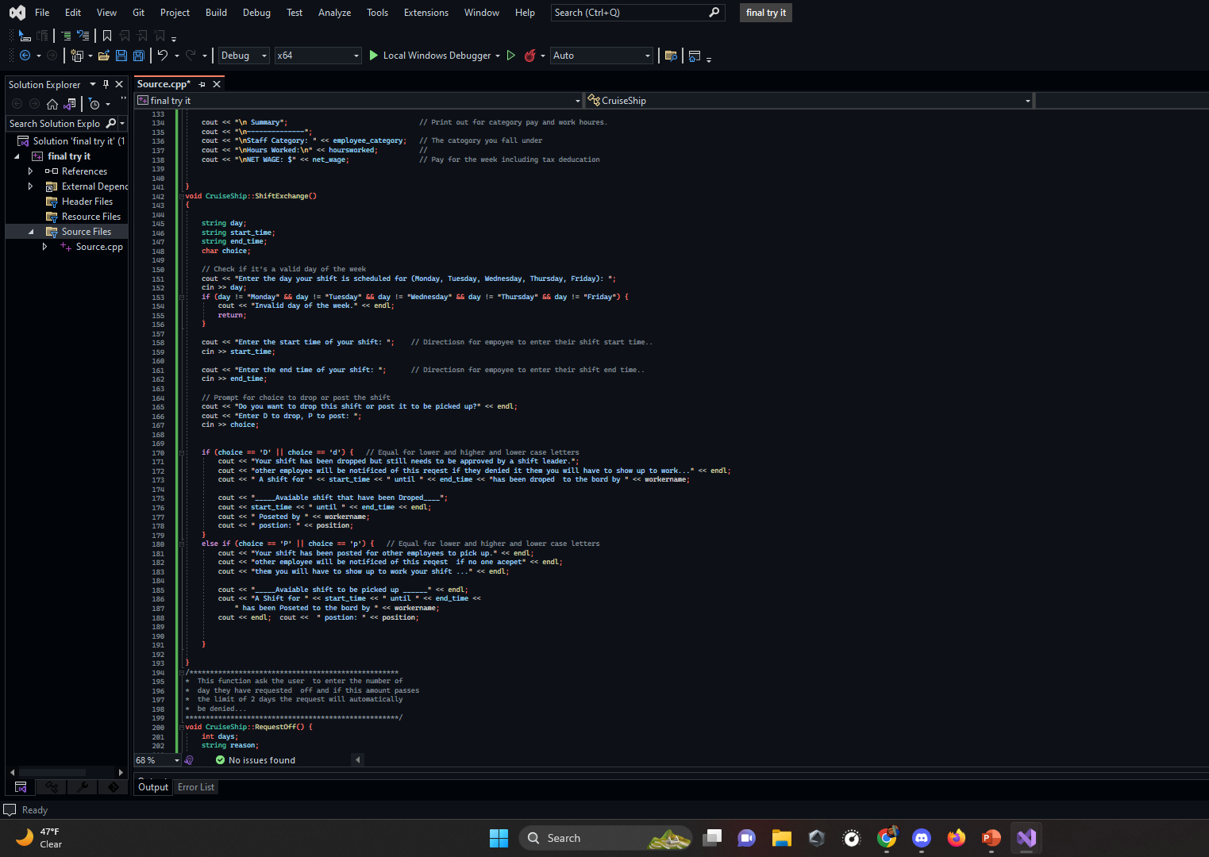
Shift exchange function
The function ask the user to input the day, start time, and end time of their shift. It then prompts the user to choose whether to drop the shift or post it to be picked up by other employees. Depending on the user's choice, the function will output a message indicating whether the shift has been dropped or posted and display the information about the shift.

Slide 5
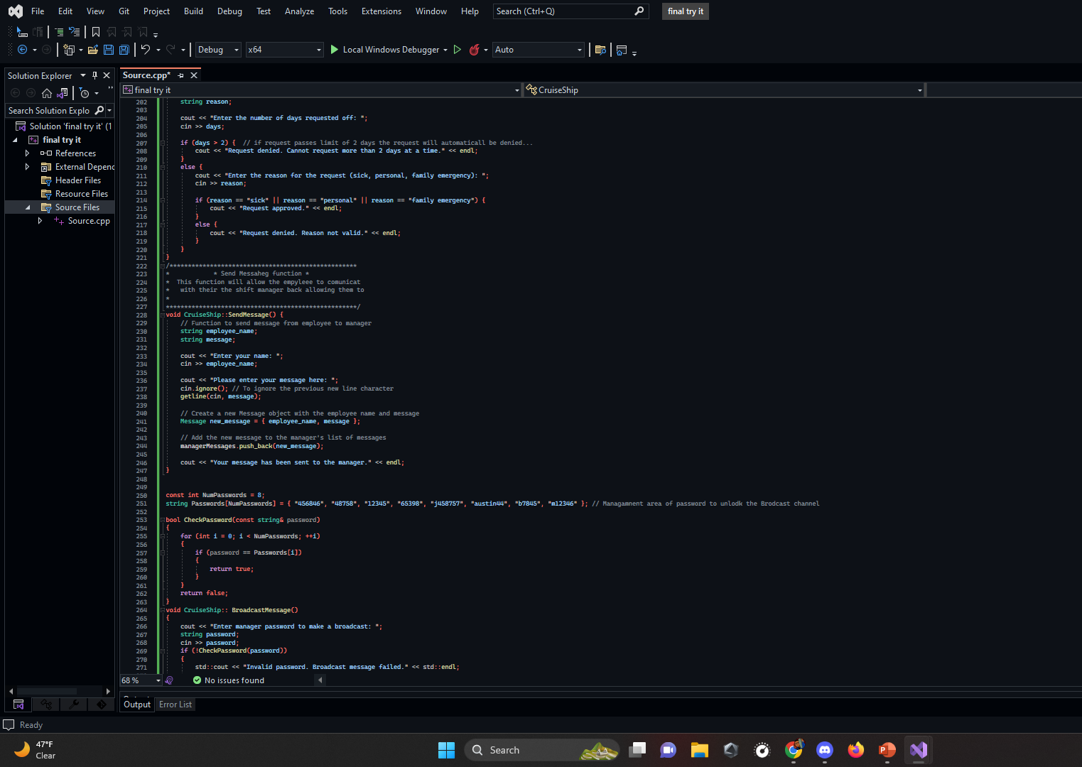
Request Off/ Passwords function
This function ask the user to enter the number of day they have requested off and if this amount passes the limit of 2 days the request will automatically be denied...

Slide 6
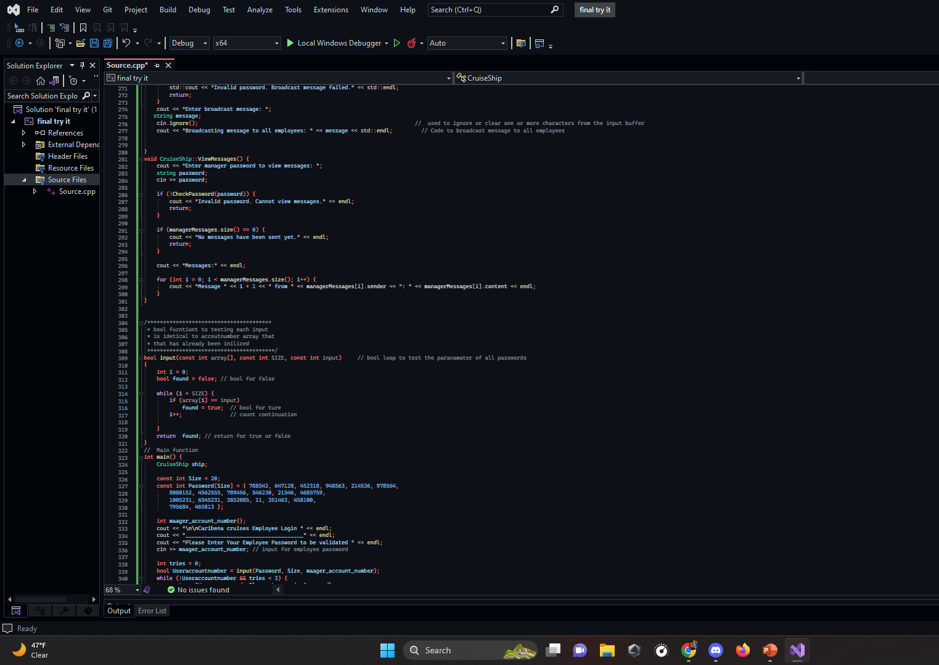
Messages/ Broadcast function
Message functions ask the user witch check Password function to test if password is invalid then prints a message and returns. Otherwise, it checks if there are any messages in the managerMessages vector. If there aren't any, it prints a message and returns. If there are messages, it loops through the vector and prints each message's content and sender.

Slide 7
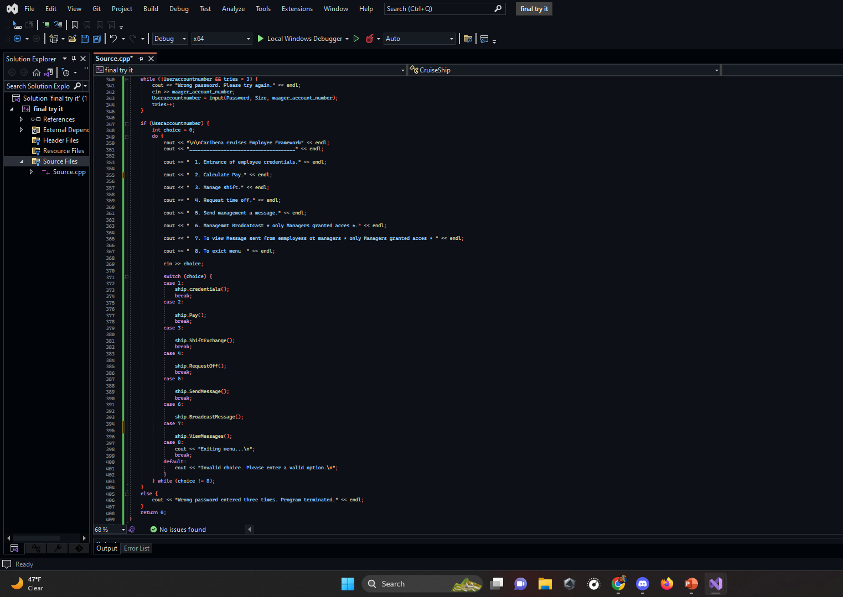
Main Function

Slide 8

Details
The program prompts the user to enter their provided password, then they will be given a menu of options to choose from. To enter their credentials, calculate pay, manage shifts, request time off, send messages to management, broadcast messages (only for managers), and view messages (only for managers).
We use an object of the Cruise Ship class to call member functions for each option . Then I programed the using a switch statement to find which option the use selected and while loop to continue the menus until the user decided to exit the menu .

Slide 9
Challenges that I faced
Finding a way continue the menu sorption until the user decide to break the cycle.
Message que system for all messages to be view by management.
Making sure that All inputs for the user could be validated.
Error system: making sure that the program would handle any error in a delicate way

Slide 10

Things I would like to Incorporate
Inheritance
For multiple classes defined specifically for management to view, all worker's credentials, schedules and messages
Polymorphism
For all employees to be defined such as cooks, Deck Crew, Cruise Directors, Expedition Leaders, Hosts and Hostesses, Naturalists, Shore Excursion Managers, and Masseuses.

Slide 11
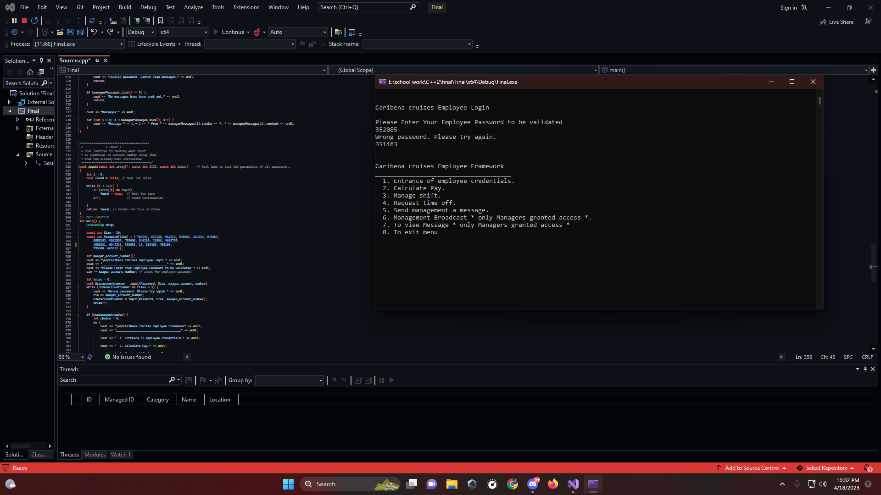

Slide 12
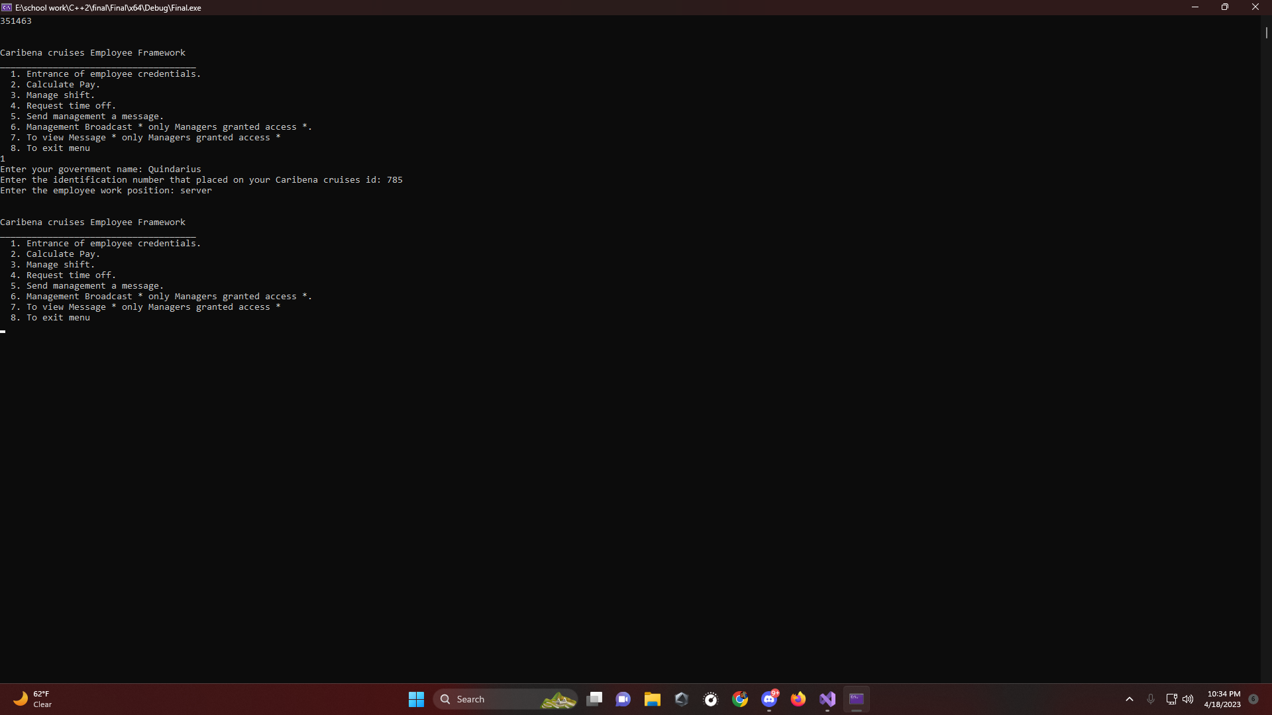

Slide 13
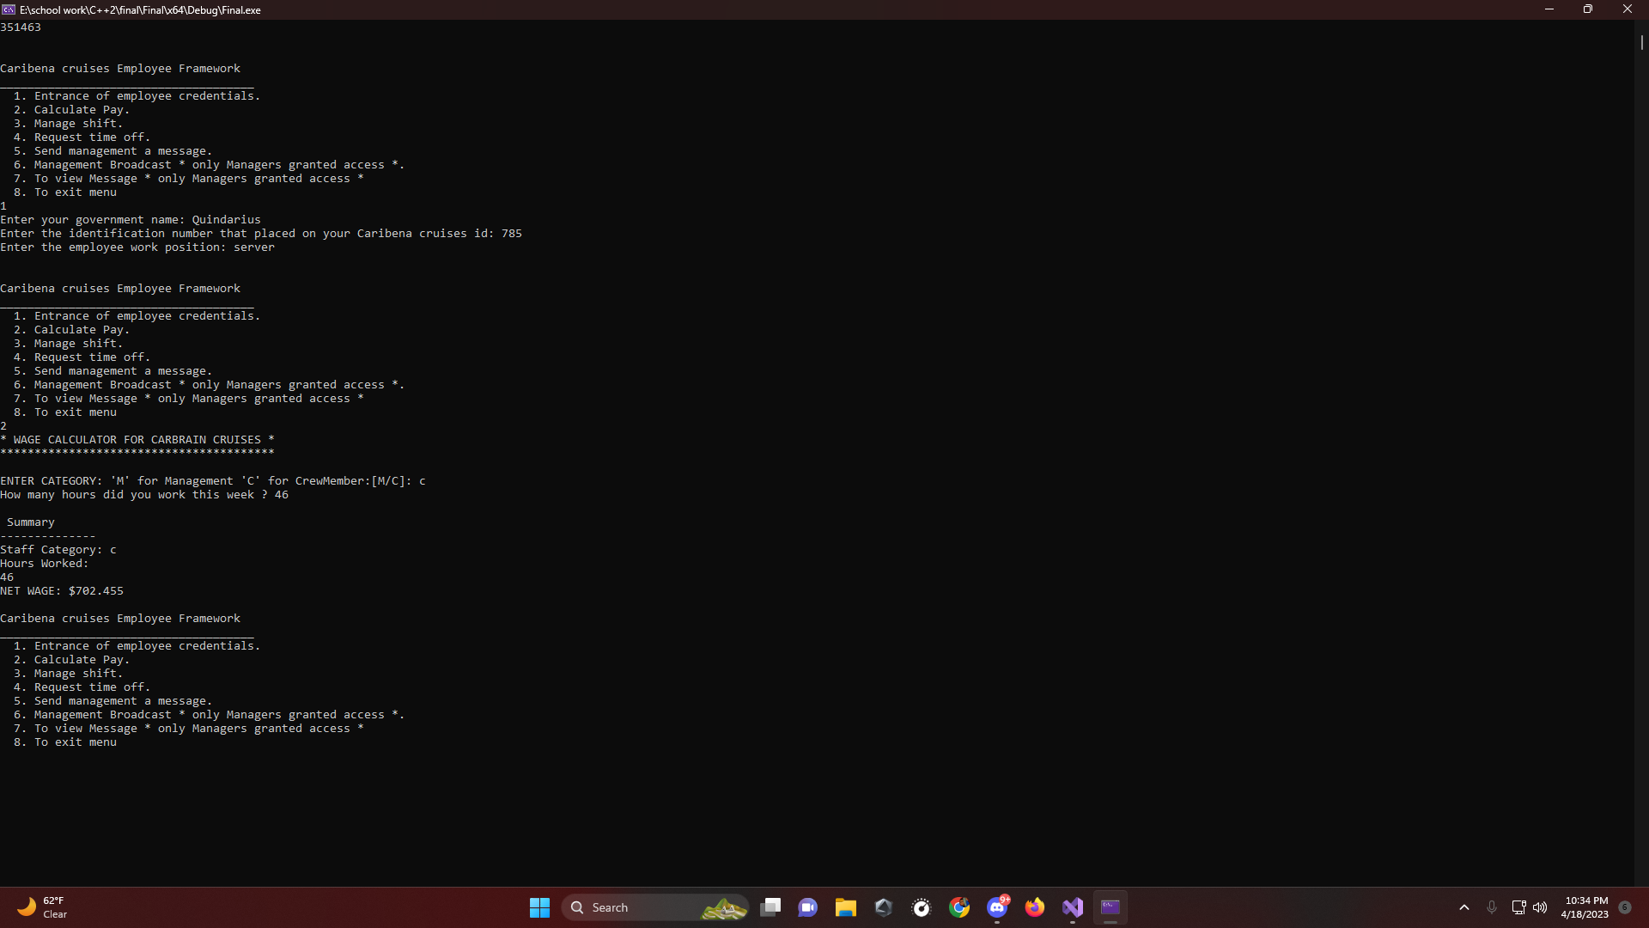

Slide 14
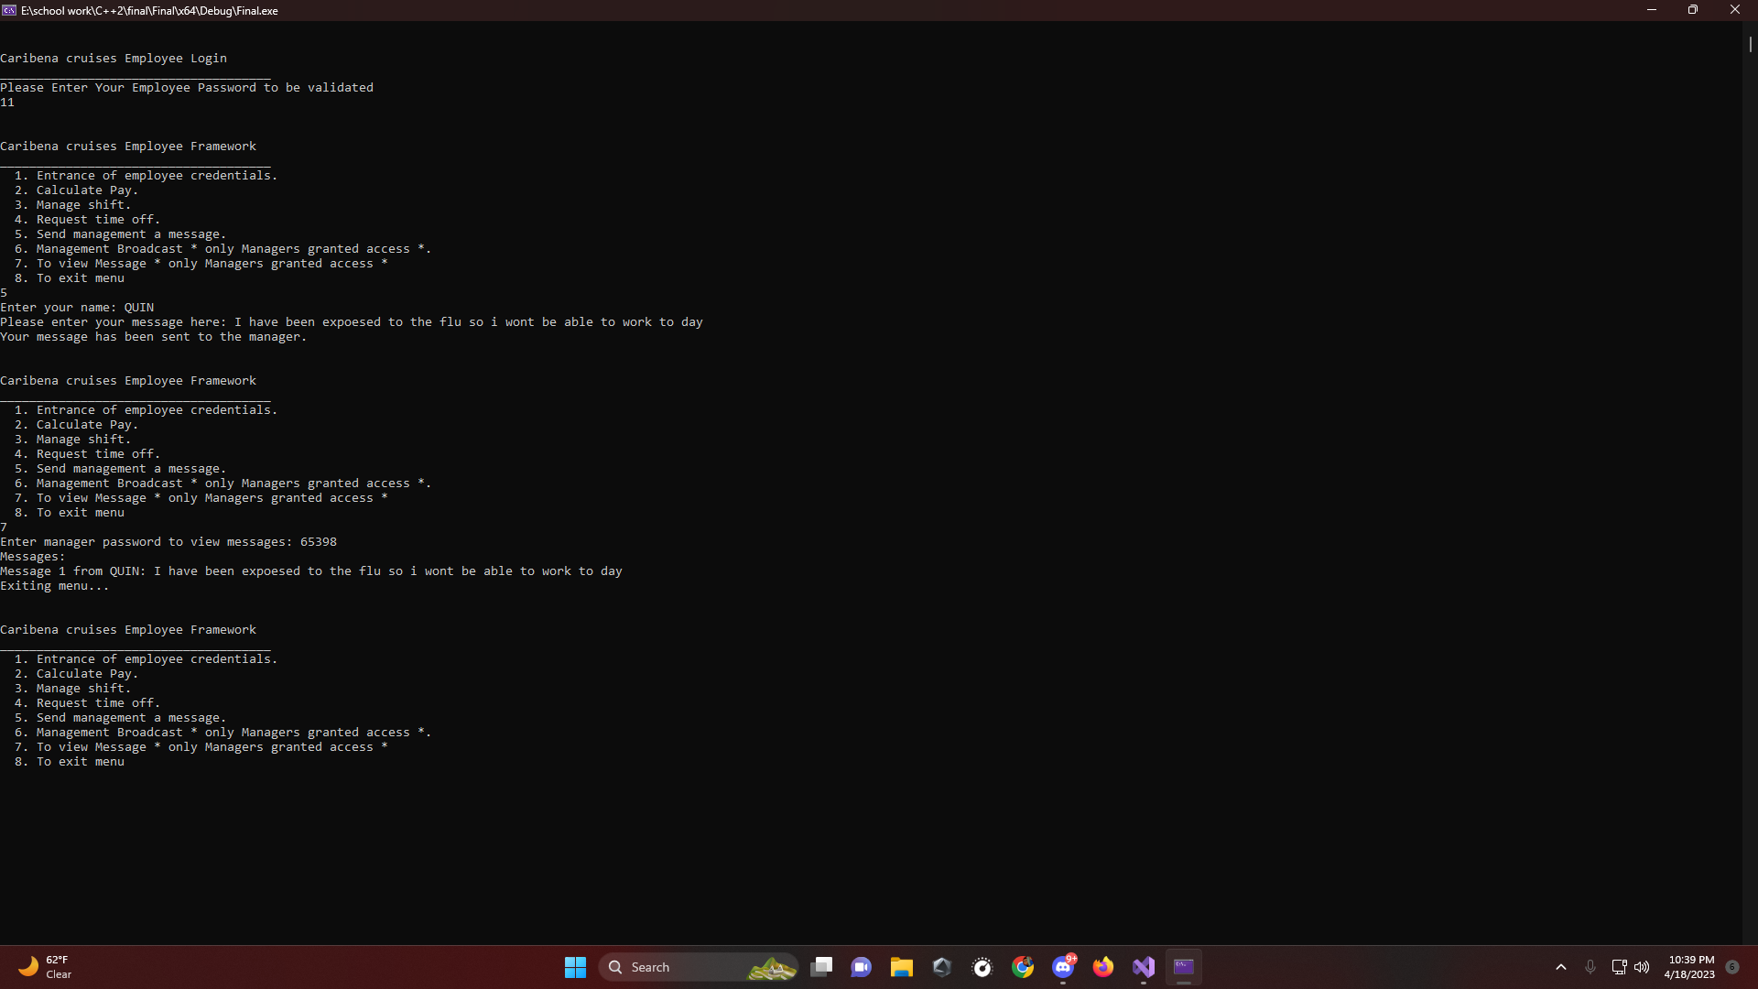

Slide 15
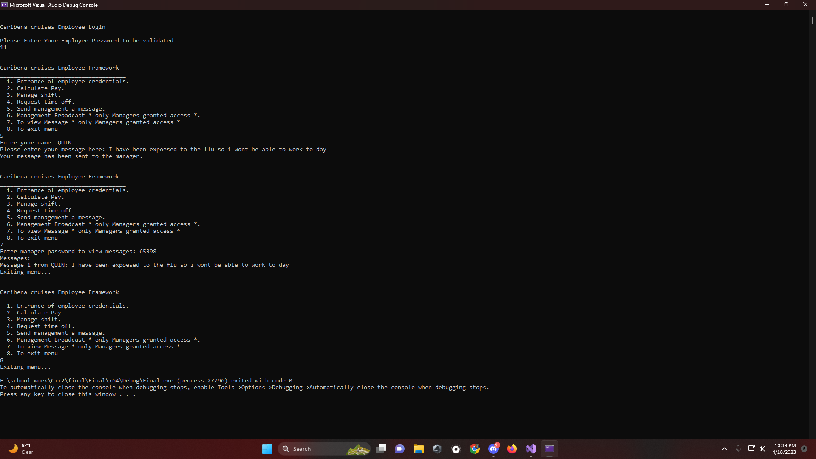

Slide 16
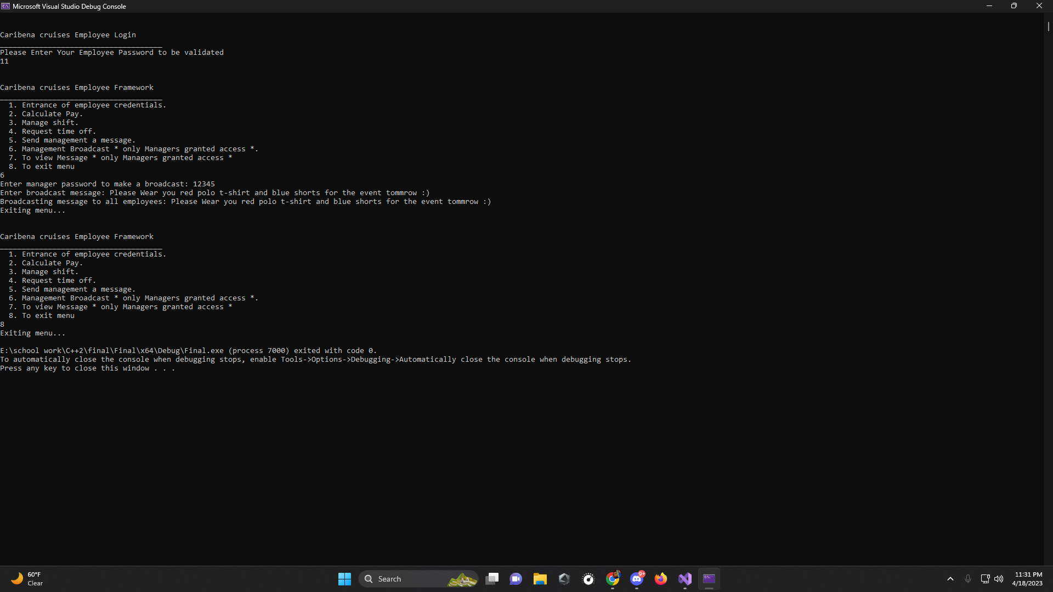

Slide 17
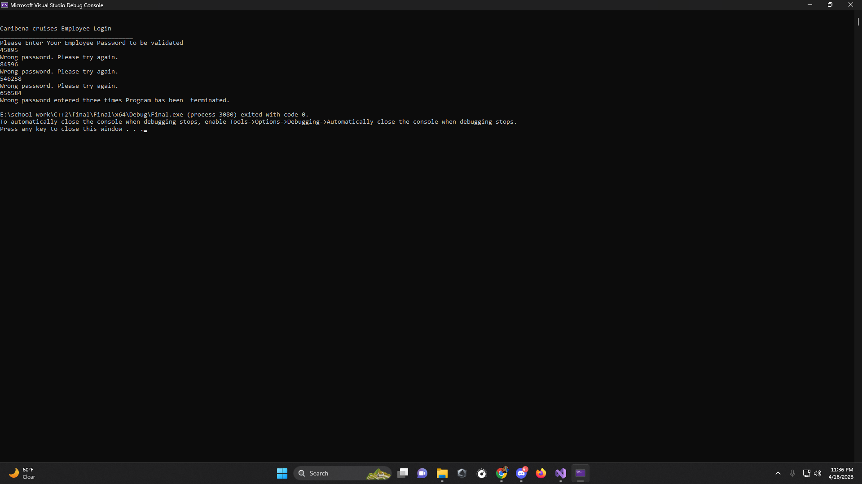

Slide 18
Helpful sources
https://www.geeksforgeeks.org/program-to-check-the-validity-of-a-password/
https://www.geeksforgeeks.org/switch-statement-in-cpp/
https://linuxhint.com/cin-ignore-cpp/
https://cplusplus.com/forum/beginner/21033/
https://www.w3schools.com/cpp/cpp_structs.asp

